Slide 1

Bad Visualization
7206 Story Telling With Data | Izzie Mirghani

Slide 2

Misleading Chart

Slide 3
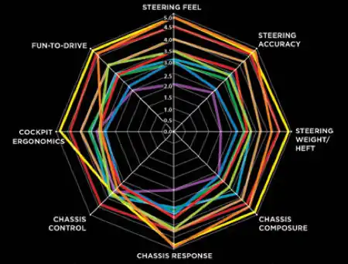
Misleading Chart
Cons:
No chart title
No legend
No context on how scores were developed
Low resolution
No definition of products assessed or data source
Too many colored lines, audience cannot focus their attention
Too many categories displayed
No “point” or insight for the audience to take away.
Too much variance on its axis.
Source: The Guardian: 16 useless infographics
Pros:
Has aesthetically pleasing formatting
Black background and white contrast
A lot must be changed
Notes:
Harjot mentioned that this possibly an internal VW chart that was used to compare different models. He said it looks extremely familiar.

Slide 4

Reasoning for Chart Selection

Slide 5
Was there a particular product vertical you pursued?
I did not explore a particular product vertical, but I did explore a type of visualization vertical. I have never created a radar chart before, so I wanted to enhance my capabilities. I thought it would be a helpful learning experience.
I think radar charts can be extremely helpful and add a lot to an analysis if done correctly, but they are easy to misconstrue and lose the audience. I wanted to challenge myself to make one that everyone can understand.
Instead of trying to track down car performance data, I picked a new topic to portray on the radar chart. I also wanted to build a much better visualization with Python to further build my coding skills.

Slide 6
If so, why? Does this chart mean anything to you?
The chart means something to me, as I have always wanted to create a radar chart for product attribute comparison. Although, the car topic does not resonate with me, the AI model topic does. At work, I am running into questions about which AI model to use for which use-case for our AI solution. I have often thought about creating something like this for project teams but never had the opportunity to explore it.
In past projects, I wanted to create radar charts in Python but never got the chance to.
I chose mainstream LLMs that the average person would use, and tried to highlight some of the main players in the industry. This visualization focus could help provide some insight on 1) which model to choose for each use-case; 2) which model is the most well rounded and highest performing; 3) potentially persuade consumers to use Anthropic over the competitors.
Prior to reviewing the data for the assignment, I did not want to focus on a company or certain null hypothesis until I noticed that Anthropic had a high volume of high-quality models ranked above many of its competitors. Once I noticed this, it became clear that this was a perfect insight to show on my chart.
I am potentially biased, but I use many different Claude models in our AI solution at work and appreciate the performance, speed, and quality of the models. I think highlighting this insight could potentially help my classmates and other consumers have a similar pleasant experience.

Slide 7

Further Improvements

Slide 8
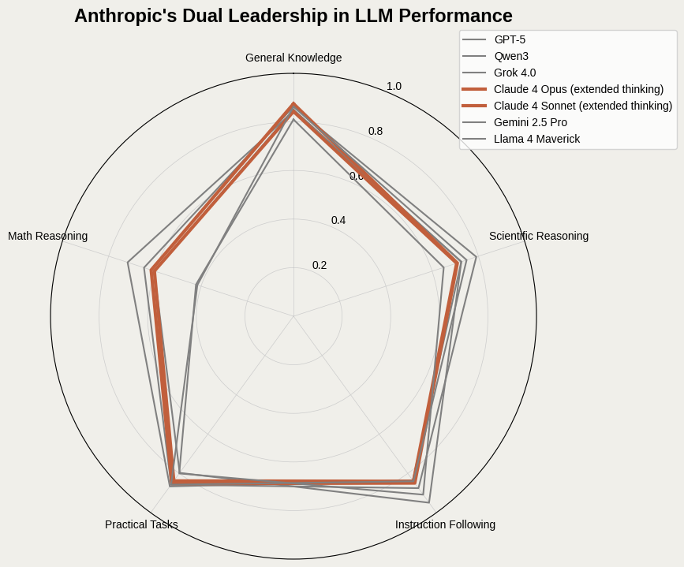

Major Improvements (Draft)
Claude 4
Opus
Ranked mainstream LLMs based on 5 different metrics.
Scores developed from 0-1.
Insight: Anthropic stood out, with two models in the top 10 rankings.
For audience understanding, only ranked mainstream models.
Bolded and colored Anthropic model’s performance to highlight their dominance.
One of Anthropic’s models is the leader in the general knowledge category
Qwen3
GPT-5
Qwen3
Grok 4.0
Source: Stanford Center for Research on Foundation Models HELM
Notes:
This was my first draft.

Slide 9


HeLM Data Context | Creator | Mean Score | HeLM Leaderboard Ranking
GPT-5 | Open AI | 0.807 | 4
Qwen3 | Alibaba Cloud | 0.798 | 5
Grok 4.0 | xAI | 0.785 | 6
Claude 4 Opus |  | 0.78 | 7
Claude 4 Sonnet |  | 0.766 | 10
Gemini 2.5 Pro | Google | 0.745 | 14
Llama 4 Maverick | Meta | 0.718 | 20
Notes:
This gives my data context and shows more about the data that I used.

Slide 10
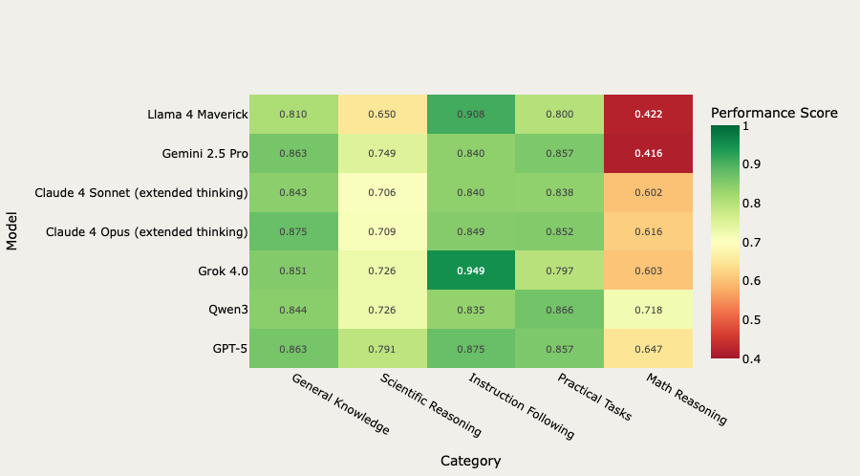

Heat Map Comparison of
Models (Pre-visualization)
Notes:
Previsualization selection work. This helped me see how each model performed on each metric and also see how low they scored on Scientific reasoning and math reasoning.

Slide 11
Misleading Chart: Solved

Slide 12
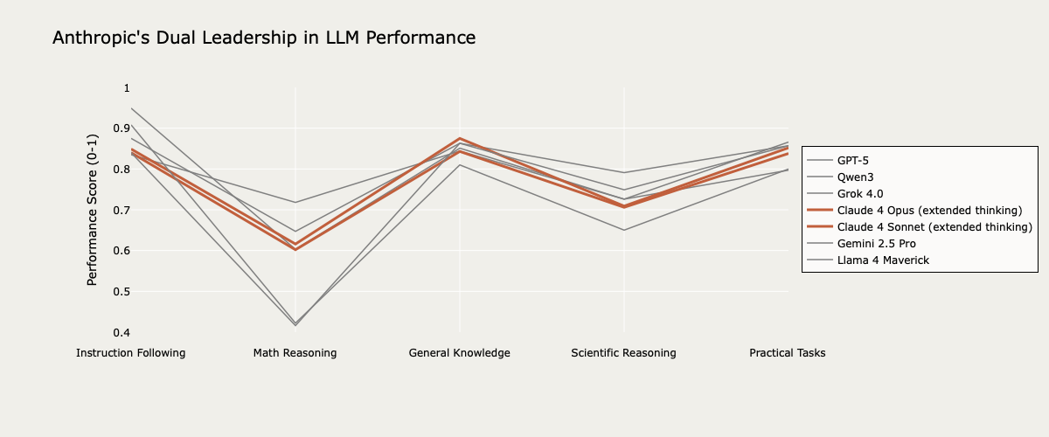
Final Visualization
Grok 4.0
Claude 4 Opus
Qwen3
GPT-5
Qwen3
Grok 4.0
Claude 4 Sonnet
Llama 4 Maverick
Gemini 2.5
Source: Stanford Center for Research on Foundation Models HELM
Notes:
This is my final visualization.

Slide 13
Important Additional Improvements
Turned the radar chart into a parallel coordinates plot to compare the different evaluation metrics. At first, I used the plotly Python package but Parcoords did not support certain line width customizations, so I had to recreate it with go.Scatter. This meant that I had to manually place each category axis at specific x-positions.
Insights:
Highlights an extremely competitive and over-saturated market.
Improving in a metric category by even 0.02 represents substantial progress, has impacts to the larger market, and potentially massive amounts of capital investment.
Many of HELMs benchmarks are approaching ceiling effects, so small differences are the only differences that are achievable with the current metrics scale.
Centering of “General Knowledge” column and focus drawn to Claude’s models
”Zoomed” into the values on the y-axis to show dispersion and difference between models.
Rearranged the order of the columns to show the general knowledge peak. Natural way to draw in the eyes.
Notes:
Competitive differentiation: In a highly saturated market, these "small" performance gaps are what companies compete on and what consumer choose between which models to use.

Slide 15
Sources
https://crfm.stanford.edu/helm/capabilities/latest/#/leaderboard
https://huggingface.co/unsloth/Qwen3-235B-A22B-Instruct-2507-FP8
https://lmarena.ai/leaderboard
https://www.theguardian.com/news/datablog/gallery/2013/aug/01/16-useless-infographics
https://flowingdata.com/category/visualization/ugly-visualization/
https://www.anthropic.com
Inspiration for the final visualization:
https://user-images.githubusercontent.com/43172056/103010194-2f5c5f00-4538-11eb-861d-e2a294e55458.png

